Slide 1

ENVIRONMENTAL MONITORING
GANESH COLLEGE OF ENGINEERING
POOJA (LEADER)
S.Narmadha
s.Rashitha

Slide 2
INTRODUCTION
Environmental monitoring
Air pollution
Air Quality
Air pollution index python
Air pollution program

Slide 3
ENVIRONMENTAL MONITORING
Only a few countries of Europe and Central Asia have been able to maintain existing monitoring activities.
The monitoring of urban air pollution — an important human health risk — is poor in many cities of the subregion.
Monitoring of transboundary air pollution also needs strengthening.

Slide 4
AIR POLLUTION
Air pollutants are known for their adverse effects on human health and ecosystems.
Pollutants also erode technical infrastructure and cultural monuments.
The air pollutants indicator assesses pressures from specific pollutants on atmospheric air across individual countries, but also identifies pressures from particular national sectors like energy, transport, industrial processes, agriculture and waste management.

Slide 5
AIR QUALITY
AQI Level AQI Range Good 0 – 50 Moderate 51 – 100 Unhealthy 101 – 150 Unhealthy for Strong People 151 – 200 Hazardous 201+

Slide 6
AIR QUALITY INTEX USING PYTHON
The air quality index is an index for reporting air quality on a daily basis.
In other words, it is a measure of how air pollution affects one’s health within a short time period.
The AQI is calculated based on the average concentration of a particular pollutant measured over a standard time interval.

Slide 7
AIR POLLUTION PROGRAM
# importing pandas module for data frame import pandas as pd # loading dataset and storing in train variable train=pd.read_csv(‘AQI.csv’) # display top 5 data train.head()

Slide 8
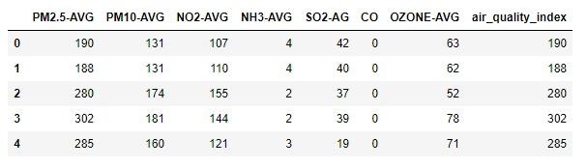
OUTPUT

Slide 9
# importing Randomforest from sklearn.ensemble import AdaBoostRegressor from sklearn.ensemble import RandomForestRegressor # creating model

Slide 10
M1 = RandomForestRegressor() # separating class label and other attributes train1 = train.drop([‘air_quality_index’], axis=1) target = train[‘air_quality_index’] # Fitting the model m1.fit(train1, target) ‘’’RandomForestRegressor(bootst

Slide 11
‘’’RandomForestRegressor(bootstrap=True, ccp_alpha=0.0, criterion=‘mse’, max_depth=None, max_features=‘auto’, max_leaf_nodes=None, max_samples=None, min_impurity_decrease=0.0, min_impurity_split=None, min_samples_leaf=1, min_samples_split=2, min_weight_fraction_leaf=0.0, n_estimators=100, n_jobs=None, oob_score=False, random_state

Slide 12
Calculating the score and the score is 97.96360799890066% m1.score(train1, target) * 100 # predicting the model with other values (testing the data) # so AQI is 123.71 m1.predict([[123, 45, 67, 34, 5, 0, 23]]) # Adaboost model # importing module

Slide 13
Importing module # defining model m2 = AdaBoostRegressor() # Fitting the model m2.fit(train1, target)

Slide 14
‘AdaBoostRegressor(base_estimator=None, learning_rate=1.0, loss=‘linear’, n_estimators=50, random_state=None)’’’ # calculating the score and the score is 96.15377360010211% m2.score(train1, target)*

Slide 15
*100 # predicting the model with other values (testing the data) # so AQI is 94.42105263 m2.predict([[123, 45, 67, 34, 5, 0,

Slide 16
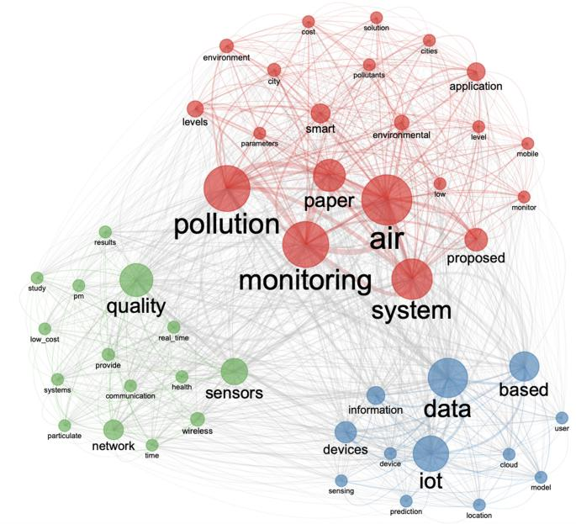
OUTPUT

Slide 17


